Slide 1

Data Structures and Algorithms
Presented by:
Elizer Ponio Jr.

Slide 2
Outline
Introduction
Big O Notation and Time Complexity
Types of Data Structures
Notes:
Have you asked yourself the question, why do people organize?
Lets go to the psychology of organizing
This predictability applies within the context of our homes, manifesting through the concept of organization

Slide 3

Are you a neat freak?
Notes:
Let me tell you a story
During the covid 19 pandemic.
too small, too big, too cluttered rooms

Slide 4
Why do people organize?
To feel a semblance of control
To know where things are without searching
People find comfort in predictability.
Notes:
Have you asked yourself the question, why do people organize?
Lets go to the psychology of organizing
This predictability applies within the context of our homes, manifesting through the concept of organization

Slide 5
What is a Data Structure?
A storage that is used to store and organize data.
It is a way of arranging data on a computer so that it can be accessed and updated efficiently.

Slide 6
What is an Algorithm?
A collection of steps to solve a problem.
Baking a cake
Going home from school

Slide 7
Why learn DSA?
To write code that is both time and memory efficient.
Commonly asked questions in job interviews

Slide 8

Introduction
Big O Notation and Time Complexity
Types of Data Structures
Notes:
Have you asked yourself the question, why do people organize?
Lets go to the psychology of organizing
This predictability applies within the context of our homes, manifesting through the concept of organization

Slide 9
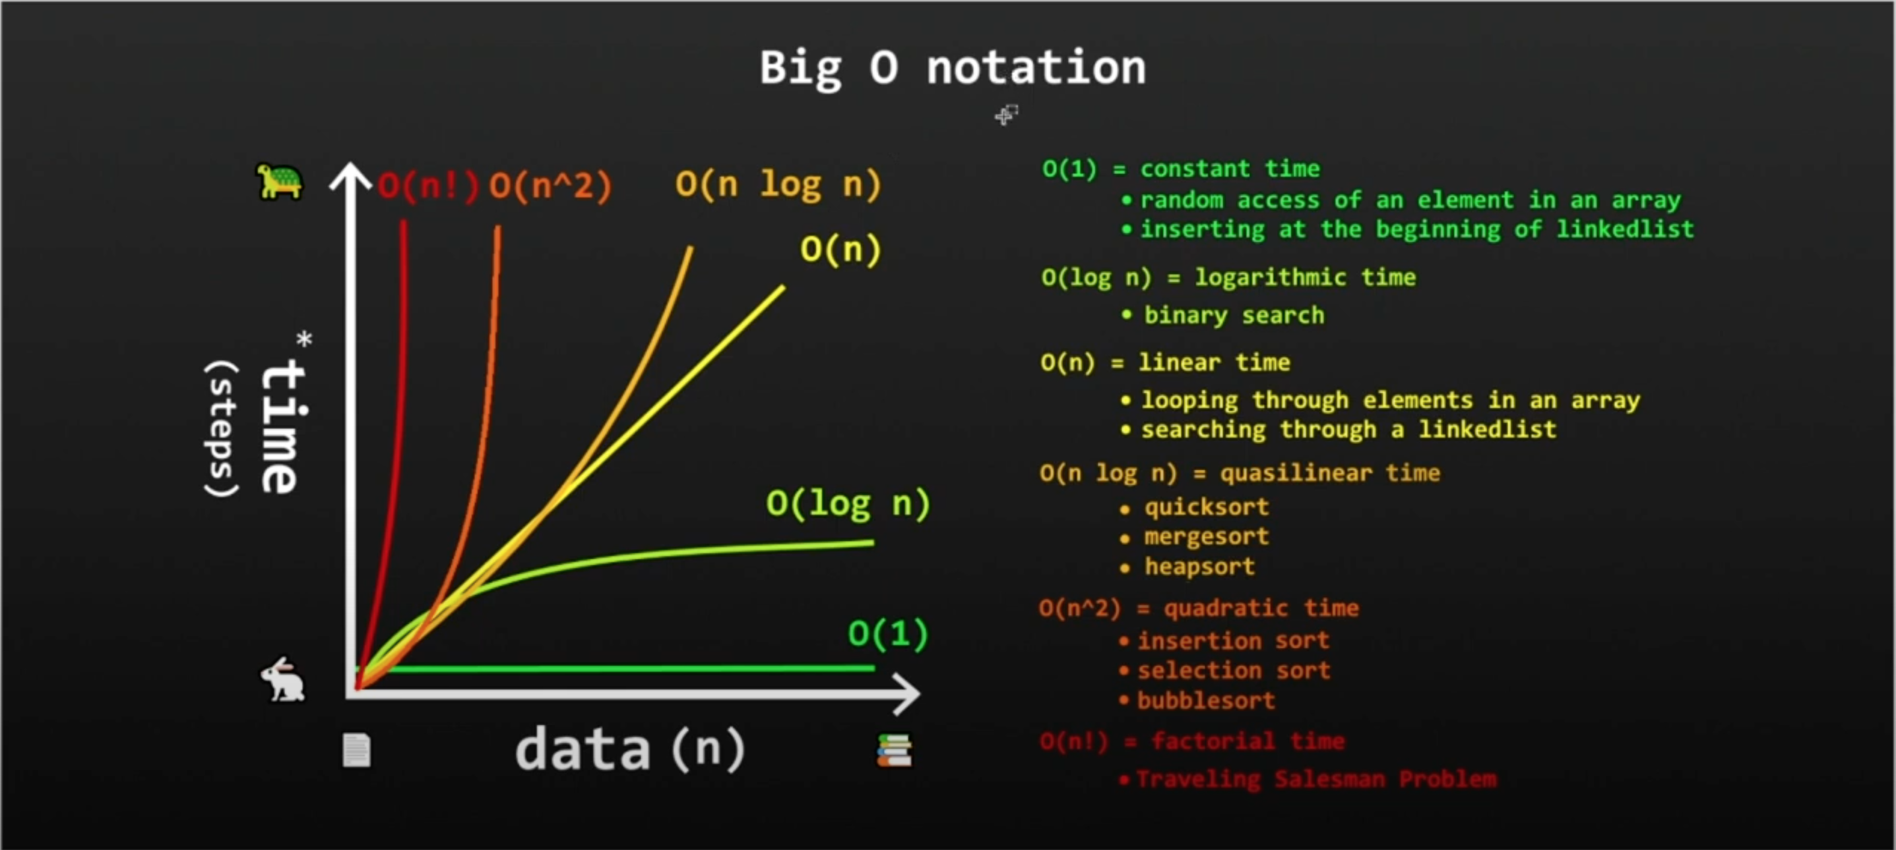
Big O Notation and Time Complexity

Slide 10
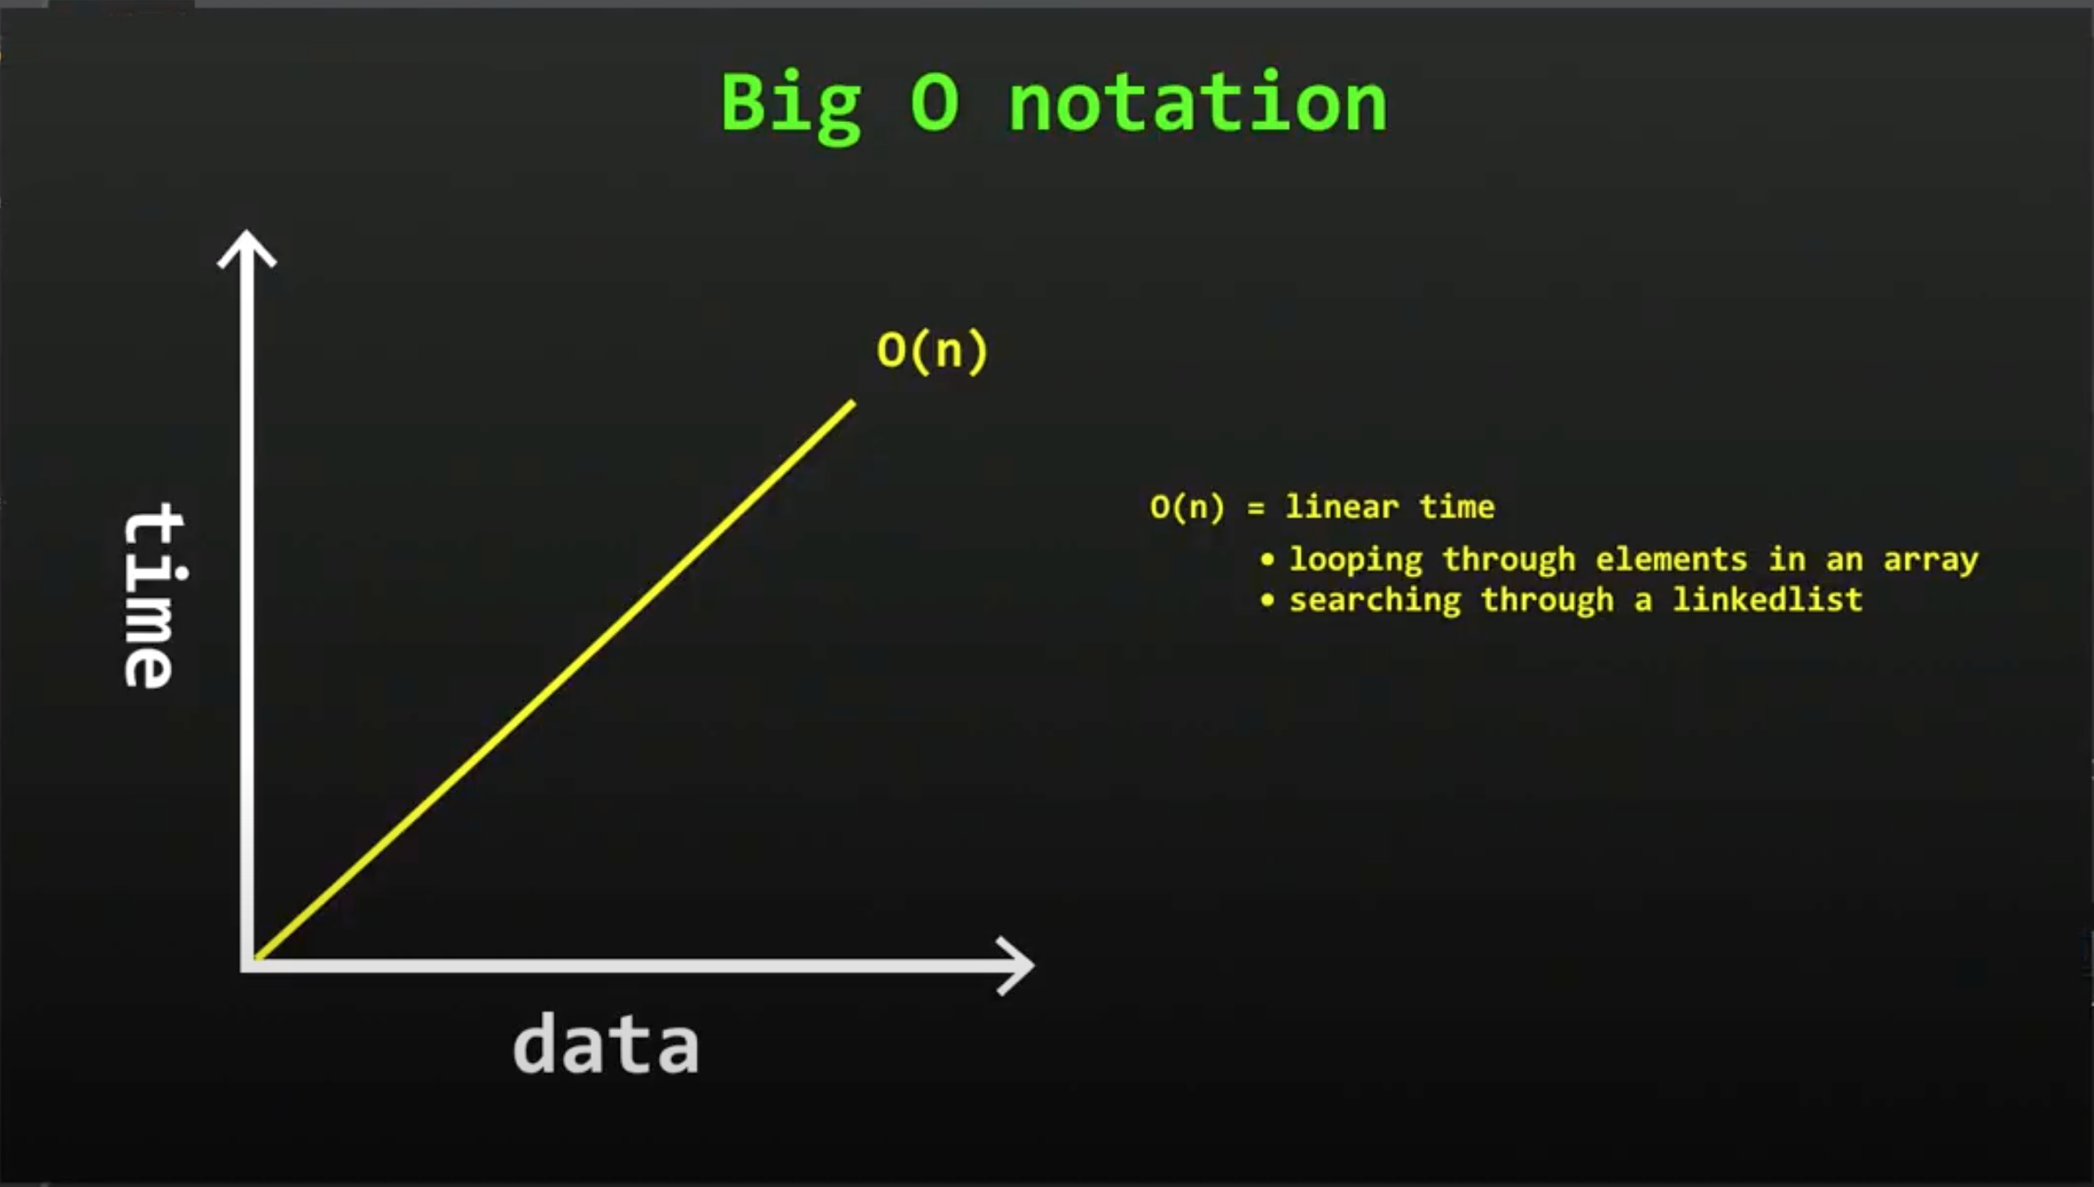
Linear Search

Slide 11
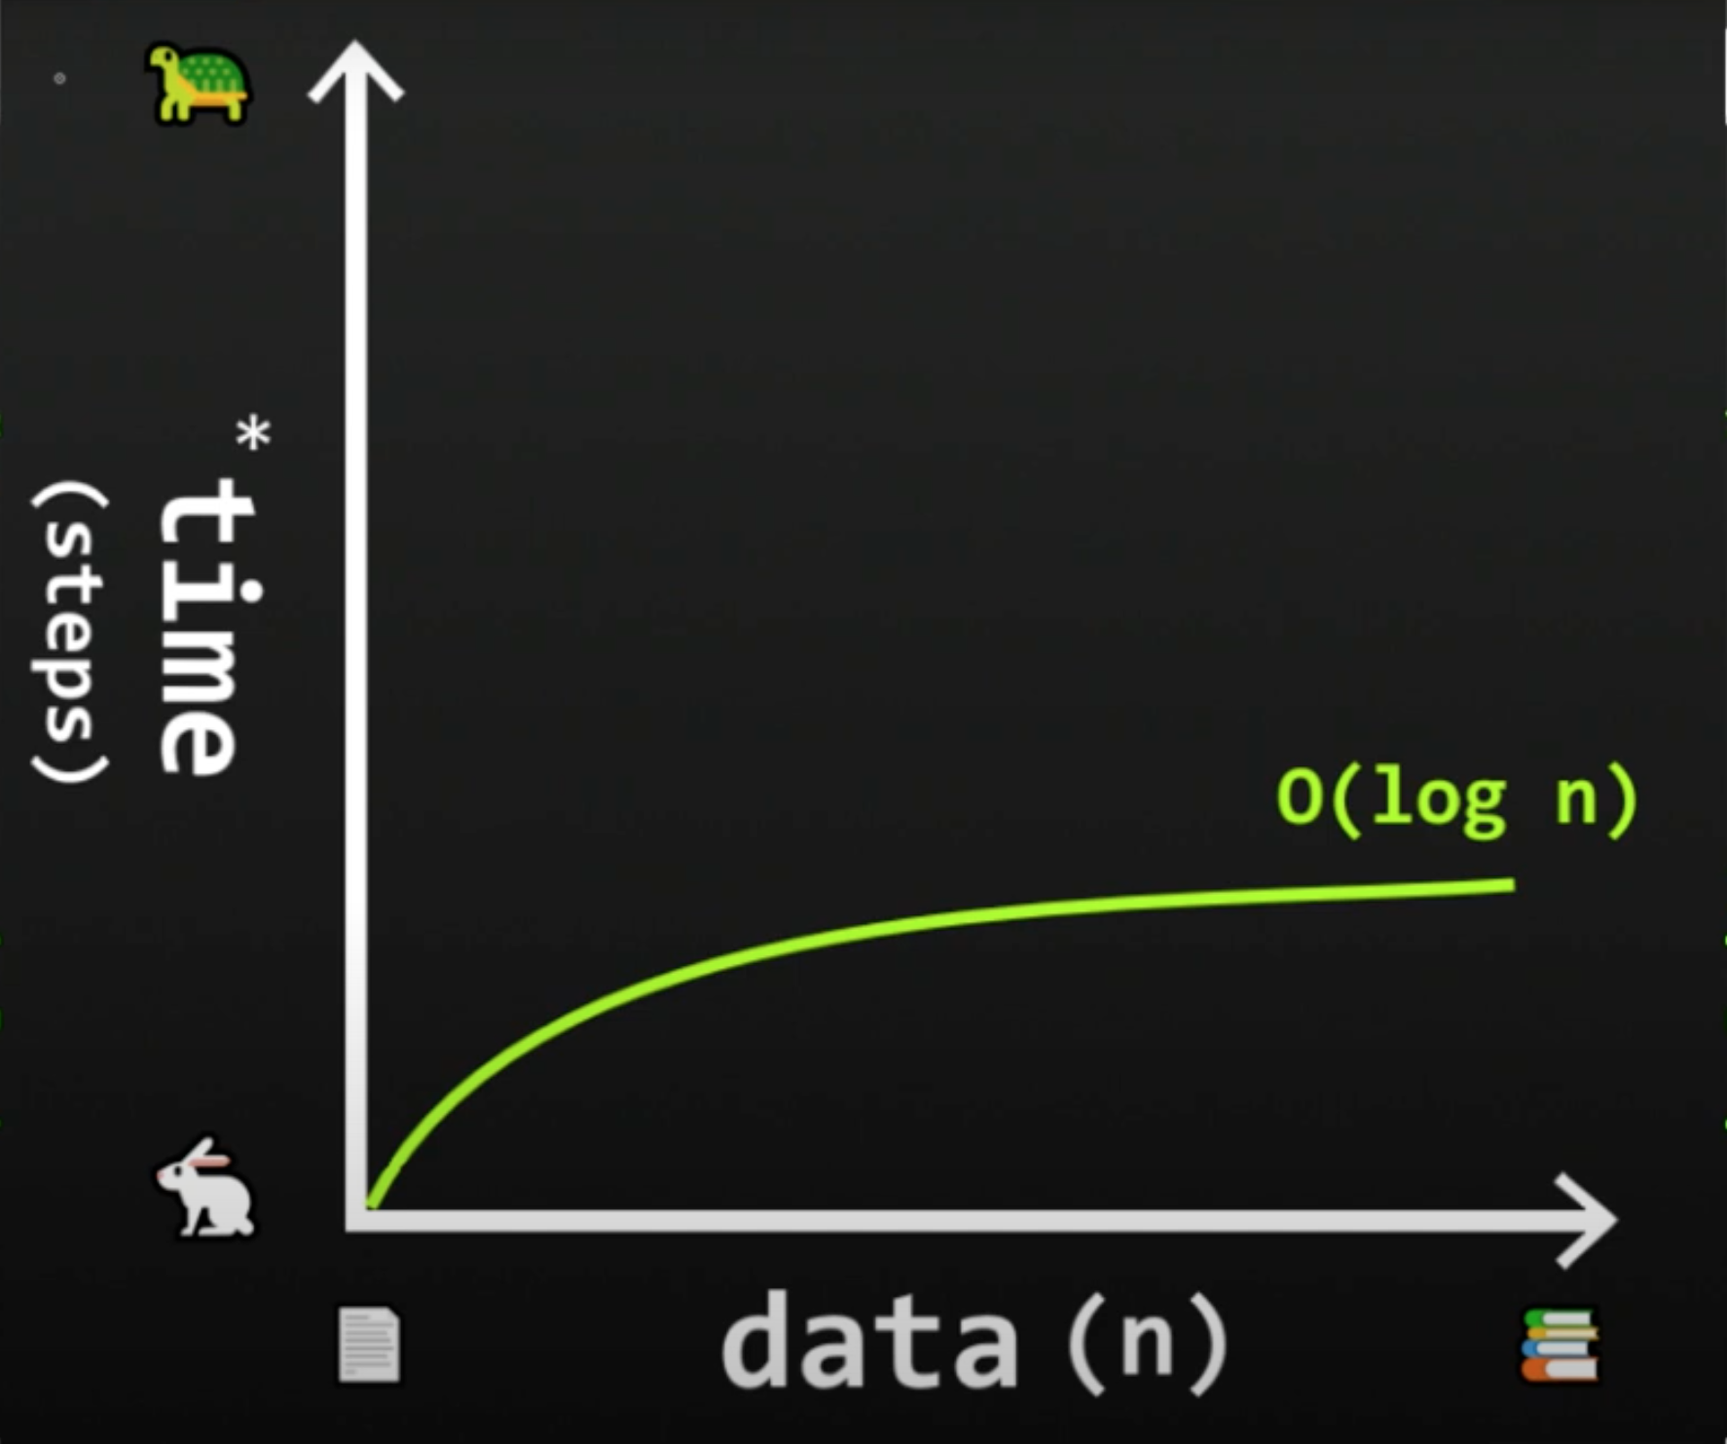
Binary Search

Slide 12
Introduction
Big O Notation and Time Complexity
Types of Data Structures
Notes:
Have you asked yourself the question, why do people organize?
Lets go to the psychology of organizing
This predictability applies within the context of our homes, manifesting through the concept of organization

Slide 13
Linear Data Structures
Data are arranged in sequence or in a particular order.

Slide 14
Arrays
A variable that can store multiple values/elements of the same type.
Each element can be accessed by their index number.
Notes:
Values technically are called array elements.

Slide 15
Arrays
Jollibee | McDonalds | KFC | Chowking | Mang Inasal
0 | 1 | 2 | 3 | 4
Notes:
Values technically are called array elements.

Slide 16
Python collection (Arrays)
List:
list1 = ['physics', 'chemistry', 1997, 2000] list2 = [1, 2, 3, 4, 5 ] list3 = ["a", "b", "c", "d"]
Tuple:
tuple1 = ('physics', 'chemistry', 1997, 2000);
tuple2 = (1, 2, 3, 4, 5 );
tuple3 = "a", "b", "c", "d";
Set:
Days = set(["Mon","Tue","Wed","Thu","Fri","Sat","Sun"])
Notes:
List items are ordered, changeable, and allow duplicate values.
Tuple items are ordered, unchangeable, and allow duplicate values.
Set items are unordered, unchangeable, and do not allow duplicate values.

Slide 17
Stack
Elements are arranged in a pile/stack.
The first element will be at the bottom.
The last element will be at the top.
Follows the LIFO (Last in First Out) principle

Slide 18

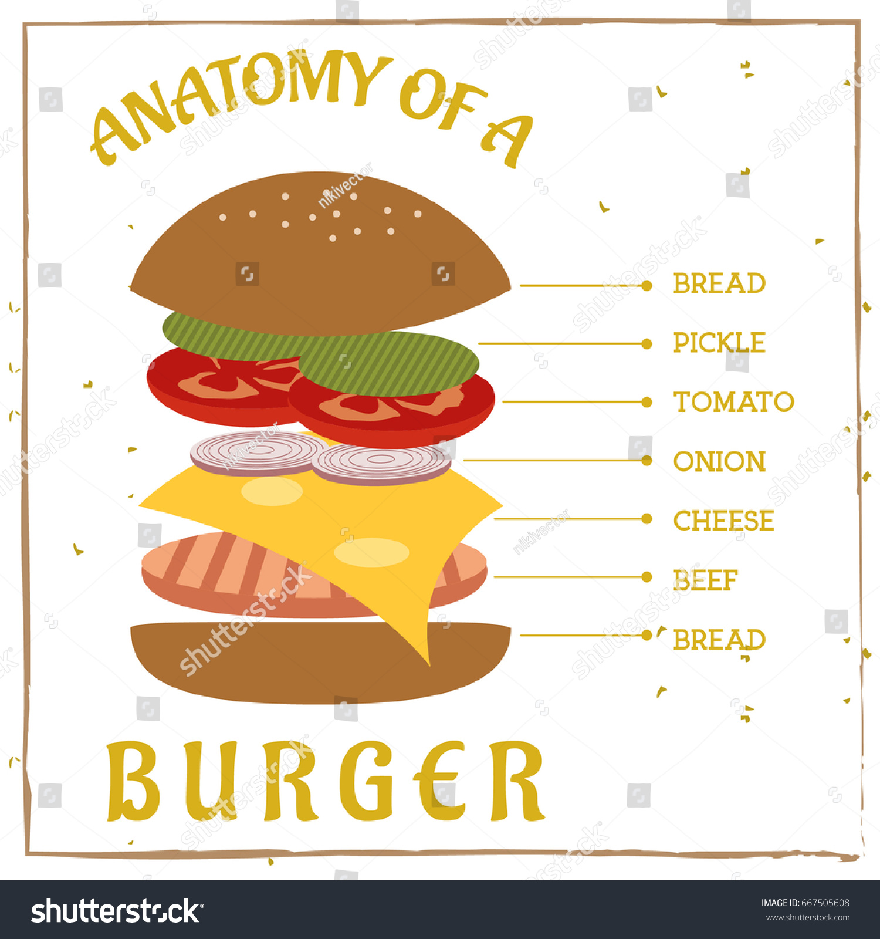
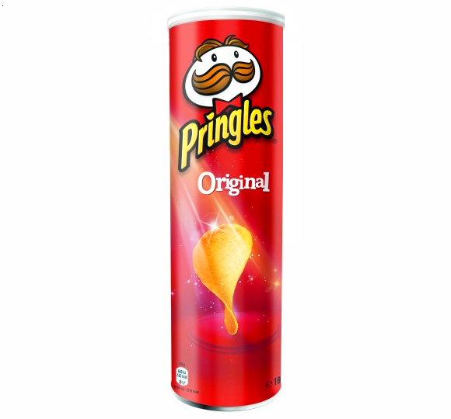
Stack
Top Bun
Lettuce
Tomato
Onion
Cheese
Beef Patty
Bottom Bun

Slide 19
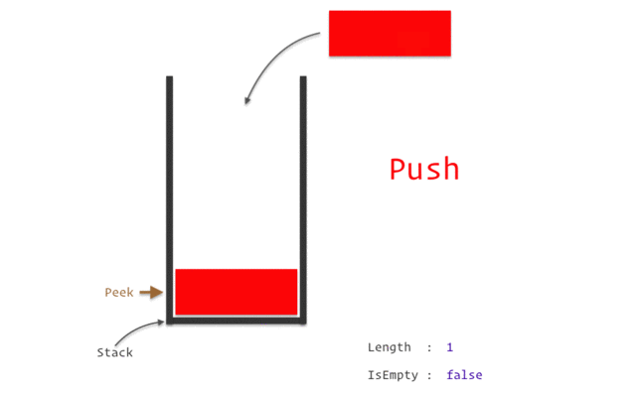
LIFO principle
Notes:
In a stack,
Removing an element is called pop.
Inserting an element is called push.

Slide 20
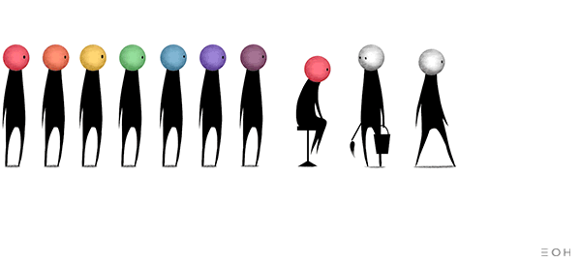
Queue
Elements are arranged in a queue.
The first element will be at the front.
The last element will be at the rear.
Follows the FIFO (First in First out) principle.
Notes:
When you go to a packed restaurant on a holiday. You sign on a waiting list.

Slide 21
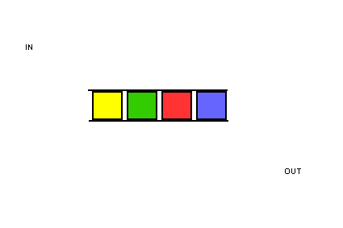
FIFO principle
Notes:
In a queue,
Inserting an element is called enqueue.
Removing an element is called dequeue.

Slide 22
Linked List
Is a sequence of linked/connected elements is known as a node.
Each node contains a connection to another node in form of a pointer.

Slide 23
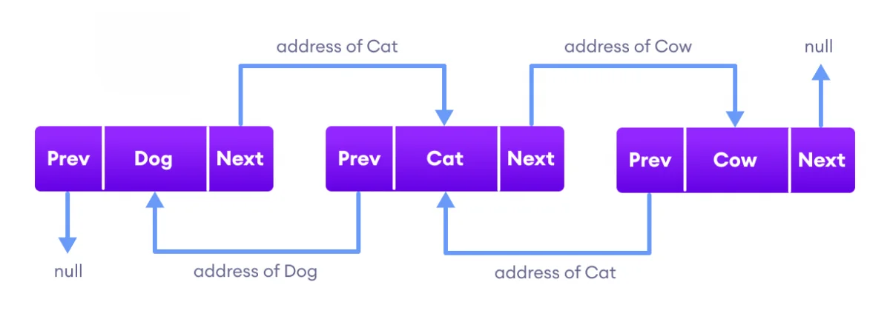
Linked List
Notes:
The previous pointer contains the address of the preceding node
The next pointer contains the address of the succeeding node.

Slide 24
Non-linear Data Structures
Unlike linear data structures, data in non-linear data structures are not in any order.

Slide 25
Hash table
Stores elements in key-value pairs where,
Key
Unique string/integer that is used for indexing/retrieving values.
Value
Data that are associated with keys.
Notes:
Have you asked yourself the question, why do people organize?
Lets go to the psychology of organizing
This predictability applies within the context of our homes, manifesting through the concept of organization

Slide 26
Key – Value Pairs
Song Title (Key) | Song Code (Value)
High hopes | 0000
This Love | 1111
God’s Plan | 2222
Sugar | 3333
Notes:
Have you asked yourself the question, why do people organize?
Lets go to the psychology of organizing
This predictability applies within the context of our homes, manifesting through the concept of organization

Slide 27

Hash table
High Hopes
0
Hash function
0 | 1 | 2 | 3
0000
Notes:
Have you asked yourself the question, why do people organize?
Lets go to the psychology of organizing
This predictability applies within the context of our homes, manifesting through the concept of organization

Slide 28
Hash table
This Love
1
Hash function
0 | 1 | 2 | 3
0000
1111
Notes:
Have you asked yourself the question, why do people organize?
Lets go to the psychology of organizing
This predictability applies within the context of our homes, manifesting through the concept of organization

Slide 29
Hash table
God’s Plan
3
Hash function
2222
0 | 1 | 2 | 3
0000
1111
Notes:
Have you asked yourself the question, why do people organize?
Lets go to the psychology of organizing
This predictability applies within the context of our homes, manifesting through the concept of organization

Slide 30
Hash table
Sugar
2
Hash function
0 | 1 | 2 | 3
0000
1111
3333
2222
Notes:
Have you asked yourself the question, why do people organize?
Lets go to the psychology of organizing
This predictability applies within the context of our homes, manifesting through the concept of organization

Slide 31
Python Dictionaries (Hash table)
thisdict = { “High Hopes": “0000", “This Love": “1111", “God’s Plan": 3333
“Sugar”: 2222 }
Notes:
Dictionary items are ordered, changeable, and does not allow duplicates.

Slide 32
Tree
A tree is a non-linear hierarchical data structure that consists of nodes connected by edges.

Slide 33
Node and Edge
Node
A
Edge
Edge
Node
B
C
Node
Edge
Edge
Edge
Edge
Node
D
E
Node
F
Node
G
Edge
Edge
Node
H
I
Node
Notes:
Nodes:
The elements that makes up the tree
Edges
The connection between two nodes.

Slide 34
Root, Parent, Child, Leaf
Root
A
Level 0
Parent Node
B
C
Level 1
Child Node
D
E
Leaf Node
F
Siblings
G
Level 2
H
I
Level 3
Notes:
Root
node at the top of the tree
Parent
A node except the root node that has one edge down to another node.
Child
A node that has one edge up to another node.
Siblings
Two or more nodes that have the same parent node.
Leaf
A node without any child nodes.

Slide 35
Height and Depth
Height = 3
Depth = 0
A
Height = 2
Depth = 1
B
C
Height = 0
Depth = 1
Height = 1 Depth = 2
D
E
Height = 0 Depth = 2
F
Height = 0
Depth = 2
G
Height = 0
Depth = 2
Height = 0
Depth = 3
H
I
Height = 0
Depth = 3
Notes:
Height of a node
- The number of edges from the node to the deepest leaf
Count starts at zero
Depth of a node
- The number of edges from the root to the node.
- Count starts at zero

Slide 36
Degree of a node
A
Degree of node A = 2
B
C
D
E
F
G
H
I
Notes:
Degree of a node
- The number of its children

Slide 37
Degree of a node
A
Degree of node B = 2
B
C
D
E
F
G
H
I

Slide 38
Degree of a node
A
B
C
Degree of node D = 2
D
E
F
G
H
I

Slide 39
Degree of a node
A
B
C
Degree of node C = 2
D
E
F
G
H
I

Slide 40
Degree of a node
A
B
C
D
E
F
G
H
I
Degree of nodes H, I ,E F, G = 0

Slide 41
Graph
A graph data structure consists of:
A collection of vertices.
A collection of edges, represented as ordered pairs of vertices.

Slide 42
Terminologies
Vertices
Vertex
Edge
Adjacency
Path

Slide 43




What is a Graph?
Jane
Ronn
Vertices:
Jane, Nica, Jonnah, Ronn
Edges:
Jane - Nica
Jane - Jonnah
Jane - Ronn
Nica - Jonnah
Jonnah
Nica

Slide 44
Adjacency
A vertex is said to be adjacent to another vertex if there is an edge connecting them.

Slide 45
Adjacency
Jane
Ronn
Jane is adjacent to Nica, Jonnah and Ronn.
Ronn is not adjacent to Jonnah.
Jonnah
Nica

Slide 46
Path
A sequence of edges that allows you to go from vertex A to vertex B is called a path.

Slide 47
Path
Jane
Ronn
Path from Nica to Ronn:
1. Nica to Jane.
2. Jane to Ronn.
Jonnah
Nica

Slide 48
Types of Graphs

Slide 49

Directed Graph
A graph in which an edge has a direction.
Tristan
Jane

Slide 50

Undirected Graph
A graph in which an edge does not have any direction.
Nica
J-Rhyzz

Slide 51
Connected Graph
A graph where every node can be visited from other nodes.
Jane
Tristan
J-Rhyzz
Nica

Slide 52
Disconnected Graph
A graph in which at least one node is not reachable from a node.
Jane
Tristan
J-Rhyzz
Nica

Slide 53
Complete Graph
A graph in which each node has edges to all other nodes
Jane
Tristan
J-Rhyzz
Nica

Slide 54
Weighted Graph
A weighted graph is a special type of graph in which edges are assigned some weights which represent cost, distance.
1
2
Jane
Tristan
J-Rhyzz
3
4
Nica

